Slide 1
Games Development
Games Program Structure
CO2301 Games Development 1
Week 19-20

Slide 2
Today’s Lecture
Cross-Platform Programming
Using Interfaces
  Code Reuse & Efficiency
3D Engine Architecture
  Manager Classes
Game Architecture
  DAGs
  Globals / “Tramp” Data / Singletons

Slide 3
Cross-Platform Programming
When possible, the technology behind a game should be independent of:
  Platform (PC, Playstation, Xbox etc.)
  API (DirectX, OpenGL, console specifics, etc.)
  Middleware (Sound API, physics engine etc.)
  Game – i.e. should be reusable for other games
This should apply to all game aspects:
  3D rendering, AI, physics, scripting etc.
How do we engineer such portable code?

Slide 4
Cross-Platform Programming
Key step is to separate commonly used code from platform/game specific code
  E.g. Managing a list of models (creation, movement, deletion) is similar on all platforms
  Whereas actually rendering the models is platform / API specific
We use interface classes and abstract classes to efficiently handle this situation
  Incomplete classes containing common code
  Further implementation classes provide platform specifics
We need to consider this separation from the beginning
  This is software architecture

Slide 5
Introducing Interfaces
An interface class (using C++ terms) has:
  No member variables
  Only pure virtual functions: prototypes with no code
Only defines functions - does not implement them
  We cannot create objects of this class
An abstract class is partially implemented:
  May have member variables and implementation
  But still has some pure virtual functions
Interface / abstract classes must be inherited by one or more implementation classes
  Which must implement all the missing functions

Slide 6
Interfaces in the TL-Engine
Interface/abstract classes define required features and provide some common code
Implementation classes provide the functionality for different platforms
  This is called a framework
The TL-Engine uses interfaces exclusively:
  I3DEngine, IMesh, IModel, ICamera etc.
Each of these classes defines a set of functions but does not implement any of them
  StartWindowed, LoadMesh, RotateX, etc.

Slide 7
Interfaces in the TL-Engine
Only the source code for the interface classes is available to TL-Engine apps through the “TL-Engine.h” header file
  This is all the specific TL-App needs to know
Inherited implementation classes are found in the TL-Engine library files
  Multiple versions are provided:
    TLXEngine, TLXMesh; IrrlichtEngine, IrrlichtMesh etc.
  Could add more (e.g. GLEngine, GLMesh)
Libraries are brought in during the compiler’s linking phase
  Source code is not made generally available

Slide 8
Interface Example
class I3DEngine // Interface class (as seen by app)
{
public:
virtual void Create() = 0;
}
// Implementation class (in the library, source code not shared)
class TLXEngine : public I3DEngine
{
public:
void Create()
{
m_pD3D = Direct3DCreate9( D3D_SDK_VERSION );
}
private:
LPDIRECT3D9 m_pD3D;
}

Slide 9
Interfaces in the TL-Engine
The ‘New3DEngine’ function is the only procedural function available in the TL-Engine
This is a factory function that creates an 3D engine of a given type (e.g. TLX)
  It returns an implementation class object
  TLXEngine or IrrlichtEngine in current version
All subsequent objects are created using this class and will be returned as matching classes:
  TLXMesh, TLXModel, etc.
The user’s TL-App is entirely platform / API independent
  Gets platform support from specific TL-Engine libraries

Slide 10
Interface Example Cont…
// Factory function – creates objects of a given type
I3DEngine* New3DEngine( EngineType engine )
{
if (engine == kTLX)
{
return new TLXEngine();
}
else // ...create other supported types
}
// Main app, ask for I3DEngine pointer of given type
I3DEngine* myEngine= New3DEngine( kTLX );
// Use pointer (underlying object is TLXEngine type)
myEngine->StartWindowed();

Slide 11
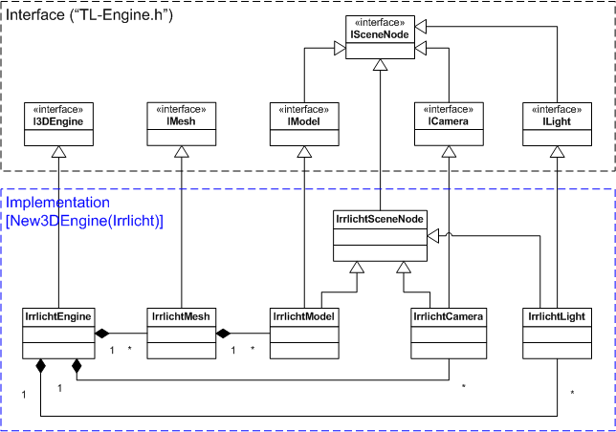
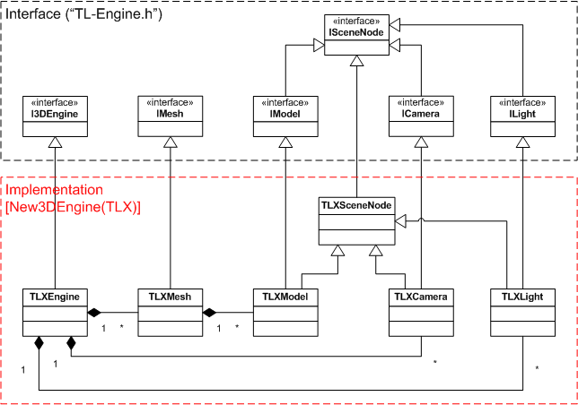
TL-Engine Class Diagram

Slide 12
Another Interface
class IModel { // Interface class (as seen by app)
public:
virtual void Render() = 0; // No code in interface
}
// Implementation class (a version for DirectX)
class CModelDX : public IModel {
public:
void Render() {
//...Platform specific code in implementation class
g_pd3dDevice->SetTransform(D3DTS_WORLD, &m_Matrix);
//...
}
private:
D3DXMATRIXA16 m_Matrix;
}

Slide 13
Another Factory Function
// Factory function – creates objects to suit engine
IModel* CEngine::CreateModel() {
if (m_Engine == DirectX) { // Engine type is known
return new CModelDX; // Return matching model
}
else // ...create other supported types
}
// Main app: ask for IModel ptr, gets type based on engine
IModel* myModel = myEngine->CreateModel();
// Use pointer (underlying object is CModelDX type)
myModel->Render();

Slide 14
Abstract Classes: Code Reuse
TL-Engine uses interfaces, not abstract classes
  All functions must be re-implemented for a new platform
There is often common code that can be identified for a game component
  Better to use partially implemented abstract classes
The underlying TLX engine takes advantage of this:
  Many classes are entirely platform independent
  Other classes have common code provided in an intermediate abstract class:
    ITextureSurface (interface class) ->
    CTextureSurface (abstract class - common code) ->
    CTextureSurfaceDX (implementation class - DirectX specifics)

Slide 15
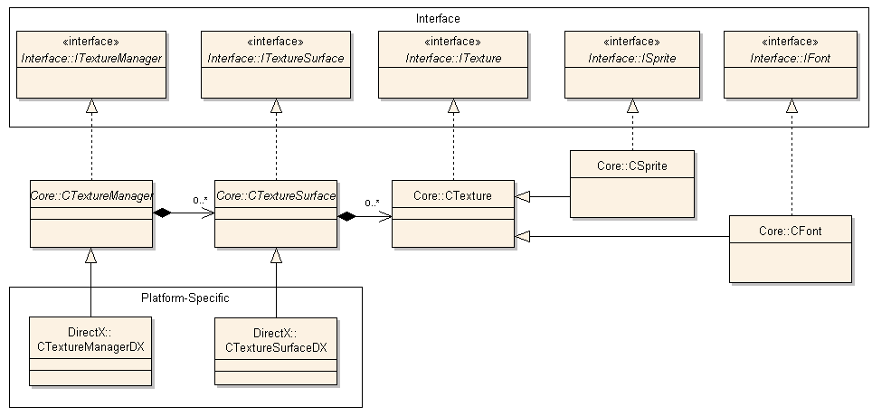
TL-Xtreme: Texture Classes

Slide 16
Framework Issues
Use of virtual functions is called polymorphism
An important OO technique, but not perfectly efficient
  Make sure interface user does not need to make very frequent polymorphic calls (e.g. thousands per frame)
  Also ensure underlying implementation avoids too many polymorphic calls
  However, don’t naively overestimate this problem. A more flexible architecture is much better than an 0.05% speed-up
Also watch out for writing over-general common code
  Too much code reuse can lead to less efficient approaches
  So write general code usable by all implementation classes
  Then allow them to override with efficient specialised versions

Slide 17
3D-Engine Architecture
A 3D Engine / API is usually controlled by a central engine / device interface class
  Providing control over core features:
    Start-up, shut-down, device switching
    Output control (window / fullscreen / multi-monitor)
    Global rendering state
The TL-Engine provides the “I3DEngine” interface
In the TL-Engine this interface also handles resource handling and a host of other features
  E.g. LoadMesh, LoadFont, CreateCamera, KeyHit…
This leads to a very bloated core class

Slide 18
Manager / System Classes
It is better to distribute related tasks to secondary manager or system classes
The core interface then provides access to these secondary class interfaces:
  Resource managers: textures, buffers, materials etc.
  Scene managers: scene nodes, spatial structures
  Also system utilities: Input, logging / console etc.
Each manager class is responsible for a certain kind of resource / scene element:
  Creation, deletion, loading and saving
  Related system and hardware settings

Slide 19
3D Engine Architecture 2
Engine user must use manager classes to create and delete resources – cannot create anything without them
  Managers are responsible for final clean-up of their resources
  Memory leaks can be made less likely (consider how TL cleans up)
They may also be used to select / use particular resources
  E.g. SetTexture – to use a particular texture
The actual resources themselves (e.g. textures) often present a very limited interface
  Perhaps only getters/setters
  Limited (if any) system / hardware control
Although the implementation classes are likely to be rather more complex

Slide 20
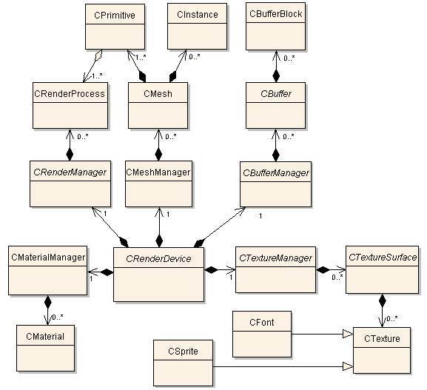
TL-Xtreme: Core 3D Classes

Slide 21
Overall Class Architecture 1
Note that there are no cyclical dependencies
  I.e. No classes that mutually depend on each other
  As illustrated by the aggregations/dependencies
We can use this as a design paradigm
  Implying that lower level classes are ignorant of higher level ones
  This strongly promotes loose coupling
This is equivalent to saying that the class structure forms a Directed Acyclic Graph (DAG)
  Tends to be a tree-like graph
  So we can identify separate sub-graphs that are also loosely coupled

Slide 22
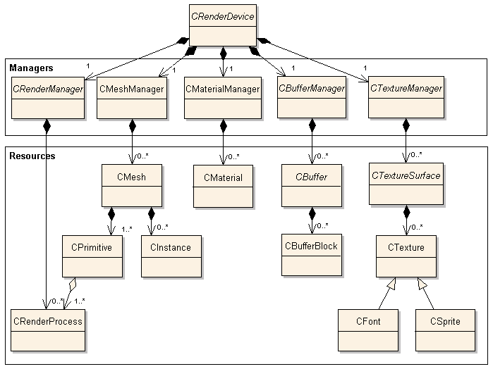
TL-Xtreme as a DAG

Slide 23
Overall Class Architecture 2
Note also that this approach shows clear lines of ownership / responsibility (compositions)
  Follow the composition arrows from the core class outwards
We should also make sure we are clear on these lines of responsibility
In general, every object should be either a core object or the responsibility of just one other object
This often leads to a tree structure for the compositions in our UML diagrams
  Not always though - use extra care for these more complex cases

Slide 24
Side Note: Global Data
The use of global data is generally bad practice, especially in larger projects
  Difficult to be certain of value / state of a global when accessible anywhere, by anyone
  Especially a problem if different team members use it
But it is common for a few key pieces of data to be required in many parts of a larger system
  E.g. the Direct3D device pointer, Device, which is used for almost all D3D calls
How to avoid the use of globals for such data?

Slide 25
Managing Widely Used Data
Three (and a half) solutions:
Use globals anyway in these rare cases
  May be OK in a simple case (purists would complain)
  Is likely to harm flexibility, and cause problems in a team situation
Pass the data around as parameters
  This can be onerous and repetitive, passing the data from class to class, function to function
  Can find data passed many levels deep (tramp data), harms efficiency surely?
  Maybe not – if only one parameter.

Slide 26
Managing Widely Used Data
Use a singleton object to hold the data
  A class that can only have one object ever created of it
    Use a special technique to set this up
  We make the object widely visible.
  Allows some encapsulation on the contained data
  But still effectively a global – can suffer the same problems
3.5 Pass global data to manager classes, but no further:
  E.g. send D3D device pointer to any manager that needs it
    E.g. CRenderManagerDX to manage D3D rendering, SetRenderState, DrawPrimitive etc.
  Objects underneath the manager class must request the manager to do any jobs that require the global, or request the global directly
    Awkward when an object needs a global but doesn’t directly have it

Slide 27
Globals through Manager Classes:
You might want an CTexture class to be able to:
  Create / destroy hardware texture resources
  Change hardware texture filtering, etc.
But storing D3D device pointer globally or per-texture might be a bad idea
  The texture class can alter non-texture device state
  Many hundreds of textures using same device pointer
  Current device state hard to track
Instead CTextureManager does these tasks:
  It stores D3D device ptr - interfaces with hardware
  Textures must call manager functions to use DirectX
Improves device encapsulation
Allows for more platform-independence

Slide 28
Disadvantages
In this example, a texture needs to call the texture manager for every hardware requirement
  Potential performance issue
Also this introduces some coupling between the texture class and the texture manager
  Textures rely on the functions of the texture manager
  Although this can be seen as an advantage:
    Texture manager class takes responsibility for texture lifetime
    Maintains consistent device state relevant to textures
Each texture still needs a pointer to the texture manager
  Is that better than a pointer to the D3D device?
  Few right-or-wrong rules in engine architecture, only choices

